Slide 1





Smart Key
PID_TG2019005195
Photo
(Author 1)
Photo
(Author 2)
Photo
(Author 3)
Photo
(Author 4)
Aravinda Kumar R C
Gouthamm Gurusamy
Rishi Kumar
Nageswarvijay S
Sri Ramakrishna Engineering College
Notes:
Title Text Font Calibri Body Bold, Font Size 34, Name and Designation Font Size 18

Slide 2

Index
1
Challenge Statement
2
Concept of the Solution
3
Novelty / Scope of Solution
4
Pros and Cons of the solution
5
Technical Description
6
Implementation Plan
7
Validation/Testing/Analysis
8
Cost Estimate
9
References
TG2019005195

Slide 3
A Technical Presentation:
Smart Key – Kharon a Smart Access Control System

Slide 4
Challenge Statement
The challenge statement expects a solution for an universal electronic key-lock system to control access to locations.
The solution should fit for all scenarios, whether it be a home door, office door or a car door, the solution should accommodate all scenarios and preferably work together intelligently.
Since keys, doors and locks are synonymous with security since primordial times, security has to be treated as the primary concern while designing and developing the system.
The solution preferred is a smartphone application which is the entry point for the user into the system.
TG2019005195

Slide 5
Concept of the solution
The Concept of the project is:
To develop a wireless, electronic and central key-lock system that can be adapted to all scenarios with little or no change, the scenarios include but are not limited to automobile, personal, home and corporate doors. Also the behaviour of the lock can be programmed and reprogrammed accordingly without changing anything on the hardware.
To develop a secure protocol christened Kharon, exclusively designed for the system to ensure state-of-the-art security in the cyber front, the protocol is designed in strict adherence to cyber security principles and is highly secure.
The end devices are BLE enabled locks fitted to doors in an ad hoc manner, these devices will interface with the locking mechanism and will lock or unlock based on commands from the smartphone app, the transactions with the smartphone will happen via Bluetooth.
An Android application is developed as POC which will turn the smartphone into a virtual key and provides the bearer entry, the various scenarios can be programmed into the App rather than affecting the changes to the hardware lock.
A central server hosted on cloud to connect all the users and locks through internet, permissions can be granted or revoked lively and remotely from an administrative dashboard, the admin user can add or remove users/roles/permissions etc.
TG2019005195

Slide 6
Novelty / Scope of Solution
The system aims to replace existing RFID based locks which requires a key-card to gain access, these are airborne systems, wherein a card is presented at close proximity to the card reader.
The system is capable of detecting approaching user within a pre-set range and needs no presentation of card or the user to even carry a card, thereby improving user experience, adding to the aesthetics of the door frame and reduces traffic.
Also the user needn't carry a card with him since all he needs is the Android Application, initiation of new users is also very quick, it can be as fast as scanning a QR code.
The system can also be reconfigured to wait for user actions to proceed with an operation.
The system utilizes a custom crafted security protocol called Kharon for all transactions, the protocol is lightweight, secure and is based on Public Key Cryptography.
The lock hardware can work without needing its own internet connection, the Android Application will provide the connectivity.
Since every request for access goes through the server it is very secure and any changes are effected immediately.
TG2019005195

Slide 7
Pros and Cons of the solution
The Pros of the solution are:
Simple and Secure with easy adaptations for all scenarios.
Quick response time, the system can detect approaching users and react appropriately even before the user is at the location.
The protocol Kharon written for this system is lightweight and is secure.
The business logic is decoupled from the hardware and is housed in the Android App / Web App.
One solution for multiple scenarios, connected centrally to a single server for authentication in multiple locations.
Highly secure and safe.
The user needn't carry physical keys hence can avoid losing them.
The Cons of the solution are:
The application requires connectivity to the server but this is to improve security and effect changes immediately.
TG2019005195

Slide 8
Technical Description
The system is an enterprise Role Based Access Control(RBAC) system with a custom authentication and security protocol called Kharon, the system can be described as an Access Control as a Service(ACaaS) product.
The system is centralized and used for access control of doors in an organization or at home.
The Components of the solution are:
The Web Server built using the Spring Framework containing the access control data and software, which is wrapped in a Docker Container and can be easily deployed on to either Azure or AWS.
The Dashboard (web application) built using Spring MVC Web Container, Thymeleaf and AngularJS for the administrator, providing creation, management, modification and revocation of users/visitors/roles/permission etc.
The Hardware(E-Lock) to be fitted on the door whose relation to the existing lock can be superposing or complementary or overriding in fashion. Any BLE 5.0 capable microcontroller with protectable flash and sufficient resources to run BLE and 6lowpan can be used.
The Android Application(KharonApp) to be distributed to the users which interfaces with the hardware (E-Lock) wirelessly through BLE. Through the app user has to solicit access to the server for authentication and entry which will be at the discretion of the permission setting provided by the administrator behind the dashboard.
Kharon Protocol is a custom authentication protocol inspired by Kerberos, developed exclusively for this system, to ensure excellent security standard, based on RSA Public and Private Key Cryptography and Advanced Encryption Standard(AES) implemented over HTTP, TCP/IP and Bluetooth Stack, and is secure as AES and RSA itself.
TG2019005195

Slide 9
Detailed Description
A. The Web Server
The web server is built using Spring Framework while bearing in mind industry standard, the service will hold an embedded MySQL Database.
The server will be wrapped in a Docker Container and deployed on a cloud service provider.
Fig 1: Database ER Model Diagram
TG2019005195

Slide 10
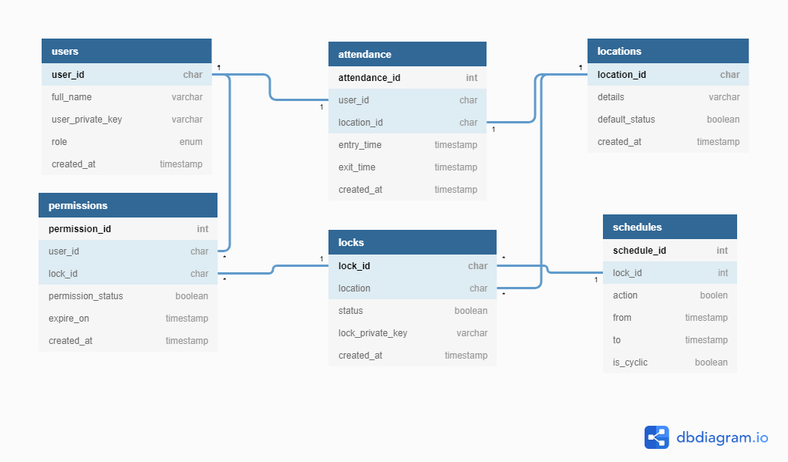
Database Entity Relationship Model Diagram
TG2019005195

Slide 11
Detailed Description
B. The Administrative Dashboard (WebApp)
The Administrative Dashboard is built using Spring MVC Container, AngularJS and Thymeleaf.
The dashboard can be accessed via a web browser.
The aim of providing a dashboard is to lively and swiftly make changes to the system remotely.
Also the administrator can view and monitor the attendance and statuses.
The dashboard will support actions for:
Creation, Deletion and Updation of User.
Creation, Deletion and Updation of Visitor.
Creation, Management and Revocation of Permission of Users and Visitors.
Creation, Deletion and Updation of Locations.
TG2019005195

Slide 12
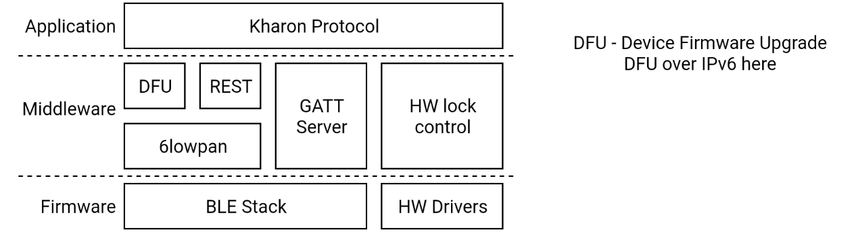
Detailed Description
C. The Hardware(E-Lock)
It hosts a BLE capable MCU that controls the lock hardware which is very flexible and can be used for any kind of lock.
The features of the lock provided by the Kharon protocol include (non-exhaustive)
Secure Self DFU using 6lowpan as and when security updates arrive
Secure Self Randomization of lock signature using 6lowpan during user connection
Registration and re-registration of lock
lock authorization
TG2019005195

Slide 13
Detailed Description
D. The Android Application (KharonApp)
The KharonApp is the user entry point, it will be distributed to the users through an online app store(Play Store). Material Design Standards by Google has been followed while designing the User Interface of the app.
The app utilizes the BLE layer android provides, to connect to the lock.
There are two modes available in the app for the user to choose from:
Auto Unlock Mode
User Initiated Unlock Mode
Auto Unlock Mode runs on an foreground service on the android device, as soon as a lock comes into range, it initiates the transactions for the user.
User Initiated Unlock Mode is event initiated, the event being a button touch inside the app.
For increased security, the key is acquired not through the network, instead the user has to scan a key and acquire it by using a QR code.
TG2019005195

Slide 14
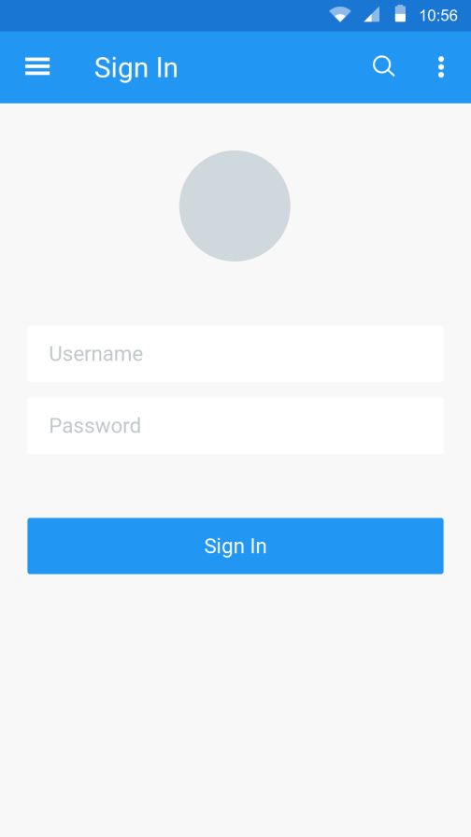
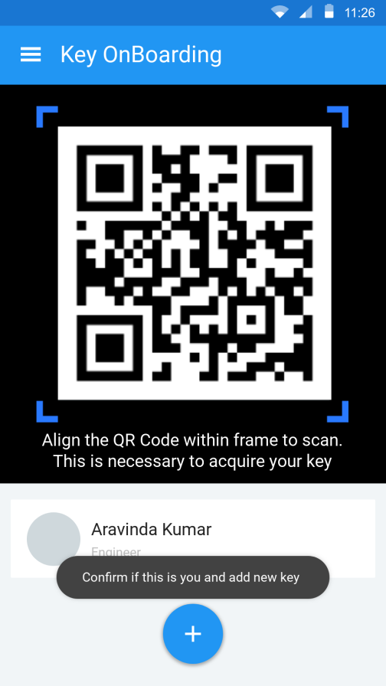
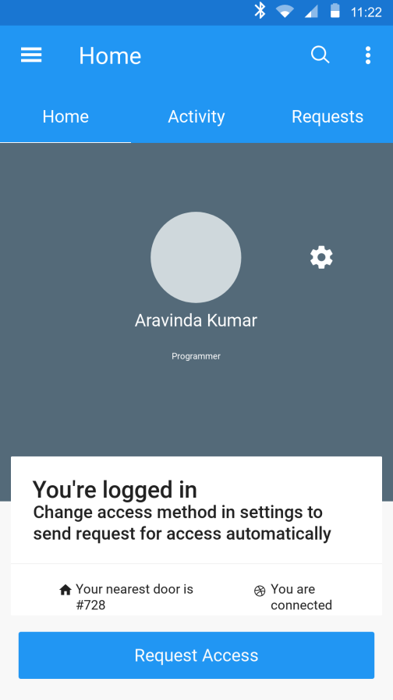
Detailed Description
The SignIn Activity
The KeySave Activity
The MainActivity
TG2019005195

Slide 15
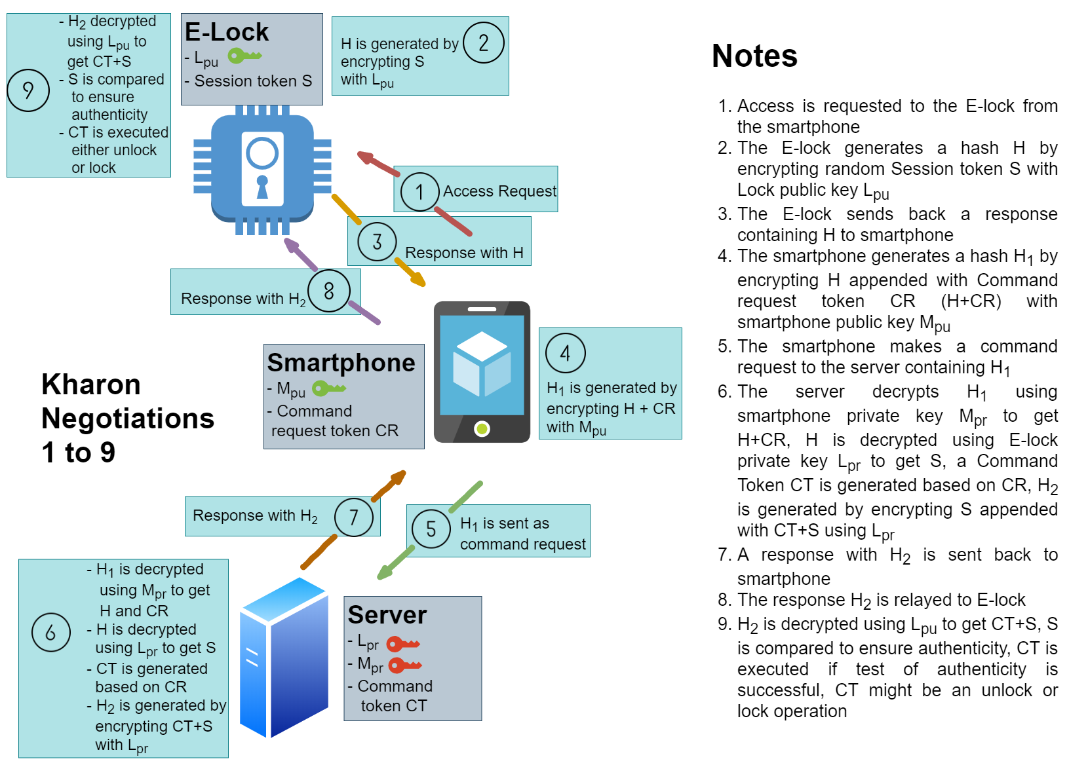
Kharon Transactions
TG2019005195

Slide 16
Implementation Plan
Protocol
Basic lock access control lists
Basic three level user roles (Admin, Maintainer, User)
Web server
Dashboard for User role control
Lock registration
User registration
Android App
User login
Lock Access Request
Maintainer Level
Lock Registration
Lock Upgrade
Lock
Secure Self Randomization
Lock access authorization
TG2019005195

Slide 17
Validation / Testing / Analysis
Test result or proof validating your mentioned solution.
The link between Server and App is a secure SSL encrypted connection.
The link between App and Lock is also secured by means of BLE link level encryption with MITM prevention.
The lock is tested for extraction of encryption keys.
The server and App is tested for vulnerabilities using DDoS, MITM, SSL.
Lock and App resiliency is tested with interference, BLE sniffing, BLE beacon type attacks.
TG2019005195

Slide 18
Cost Estimate
SI.NO | ITEM | COST(in INR)
1 | Magnetic fail secure lock | 2500
2 | BLE development board(nrf52840) | 6500
 | Total | 9000
TG2019005195

Slide 19
References
https://tools.ietf.org/html/rfc4556
https://tools.ietf.org/html/rfc6251
https://patents.google.com/patent/20160049025 (2016)
https://patents.google.com/patent/US9353551B2 (2014)
H. D. J. Jeong, J. Lim, W. Hyun and W. Lee, "A Remote Lock System Using Bluetooth Communication," 2014 Eighth International Conference on Innovative Mobile and Internet Services in Ubiquitous Computing, Birmingham, 2014, pp. 441-446.
Hengyuan Guo, Qian Zeng, Zike Chen, Ming Zhao," Bluetooth Door Lock System Based on Smart Mobile Device" CSAE '18: Proceedings of the 2nd International Conference on Computer Science and Application Engineering, October 2018 Article No.: 52 Pages 1–5,https://doi.org/10.1145/3207677.3277956.
TG2019005195

Slide 20


THANK YOU

